Slide 1
THE VIVEK HIGH SCHOOL AWARD
CEREMONY 2024-25

Slide 2
SCHOLAR BADGE AWARDEES
CLASS 4
Mehraj Veer Singh
Rihaan Sood
Kanan Goyal
Nishtha Gupta
Avanya Kant
Mahreen Kohri
Adiliya Singh
Hargun Kaur Saini
Harshat Grewal
Ruhaan Nandwani
Suhavi Kaur Gill
Humyra Kaur
Kaira Kumar
Kavya Bansal
Jasnidh Singh Gulati
Amyra Aneta
Anhad Kaur
Prabhgun Preet Kaur
Kavish Malhotra
Kanav Gupta
Rayhaan Singh Garewal
Aryaveer Jain
Aneekraj Kaur Dhillon
Gurmehreen Chahal
Sirat Malhotra
Aadhiya M. A.
Aadhvik Rattan
Krya Ranike
Saesha Garg
Siddharth Dhawan
Kyna Tandon
Anhadveer Singh Arora
Pahulpreet Kaur
Nirvaan Goel
Ayaan Jindal
Aaradhya Makker
Siddharth Aggarwal
Angad Singh
Rhea Gupta
Uday Kansal
Shanaya Banwait
Aahaan Mehta
Kaashvi Chawla
Vir Pratap Singh Dhanoa
Eshaan Garg
Himansh Capoor
Deep Kamal Sodhi

Slide 3
SCHOLAR BADGE AWARDEES
CLASS 5
Siddharth Raj
Zara Khara
Aliya Aggarwal
Amaira Mahajan
Saiyogita Kuthiala Ronav Bansal
Avikam Sood
Agastya Bansal
Sabar Dhillon
Zoya Anand
Shanaya
Veer Samrat
Samrina Sarao
Ekkansh Pahwa
Myra Jain
Advika Jain
Avirat Baboria
Tej Pratap Singh
Suhavi Kaur Gujral
Nazm Sandhu
Reneisha Arora Barapatre
Jaiveer Singh Bhasin
Jagrit Sharma
Kiara Khemani
Ganimat Dhaliwal
Ananya Sharma
Sonakshi Sajwan
Vanshika Tandon
Zorawar Singh Hundal
Arshia Kukreja
Aayansh Jund
Pravedita Jaisn
Tia Malhotra
Tuvya Goswami
Iraj Sehgal
Inayat Dogra
Reyansh Kapoor
Yuvraj Kakria
Suvir Mohan
Waris Singh Brar
Harasees Kaur
Shaina Goel
Seerat
Kushal Goyal
Rehaan
Myra Malhotra
Samreen Kaur Kang
Mehtab Singh Chahal
Parikansh Gupta
Samar Sartaj Cheema
Adaanyaa

Slide 4
SCHOLAR BADGE AWARDEES
CLASS 6
Jasraj Singh Saini
Suvira Dhawan
Shashank Seshan
Zorawar Singh Grewal
Lakith Mittal
Ambhrini Bhatnagar
Mahira Verma
Harshaan Singh Anand
Vaishnavi Donthini
Tatva Aggarwal
Seerat Kaur Randhawa
Viraaj Singh Anand
Zaina Khara
Nadia Rikhy
Namya Bhardwaj
Samrat Singh Randhawa
Prabhnoor Kaur
Arnav Gosain
Haransh Singh
Gurfateh Singh Sidhu
Zayaan Arvind Nair
Advit Jain
Agamjot Kaur
Rehan Verma
Aarav Bhutani
Eshrat Kaur Sekhon
Ayaan Garg
Ananya Khurana
Shaarav Kakkar
Kavya Walia
Anahita Grewal
Bhavyakshi Sood
Manan Chhabra
Krishiv Gupta
Dhruv Sapra
Rishaan Rakesh Rana
Pranshi Bothra
Kushangr Malhotra
Damya Gupta
Tarini Mirdha
Rabiya Kaur Aulkah
Serena Bains
Vedant Singla

Slide 5
SCHOLAR BADGE AWARDEES
CLASS 7
Sara Sharma
Nihaal Raj Singh
Ruhani Mahajan
Kovid Aggarwal
Yahvi Bansal
Tashvi Goswami
Navya Garg
Prithish Gupta
Vivaan Ahuja
Aditveer Singh
Siddharth Mittal
Jaiveer Dhaliwal
Saisha
Agastya Uttam
Shaaktak Kapoor
Rabaani Kaur Sobti
Aarush Walia
Arsheen Kaur Narang
Karan Singh Birdi
Shehaan Jain
Nayah Mittal
Kriday Kukreja
Pranusha
Aashna Garg
Naaz Mujral
Taisha Jain
Suhaya Sidhu
Sifat Wadhwa
Ayaan Bansal
Harbakhshish Sachdeva
Fateh Bishnoi
Sadaaqat inder Dhaliwal
Krishang Goyal

Slide 6
SCHOLAR BADGE AWARDEES
CLASS 8
Srishti
Kabir Mehta
Vivreet Kaur
Sharanya
Bhavik Mittal
Aarna Gulati
Manmeet Kaur
Sahej Bhatia
Ragnya Thakur
Kartik Sood
Paakhi Chawla
Saanvi Chhabra
Ananya Singla
Antriksh Sharma
Ananya Noorie Bafna
Nilesh Singla
Ryna Kaushik
Saher Yadav
Gurmehar Singh Sidhu
Adiraj Singh
Shaurya Bansal
Raihat Kaur Brar
Nakshatra Garg
Arnav Kapoor

Slide 7
SCHOLAR BADGE AWARDEES
CLASS 9
Advika Kishore
Ada Sawhney
Samarveer
Akansh Garg
Preetish Arora
Maurvi Thakur
Jasmeh Singh
Kalyani Thakur
Arnav Sharma
Insiya Garg
Aadya Girdhar
Naitik Garg
Kashvi Parmar
Yashnoor Singh
Aashita Sadana
Riyanshi
Khush Balasaria
Renaz Gulati
Tisya Juneja
Vedansh Rajput
Khyaati Sharma
Ishaani Uppal
Amaria Bansal
Pranay Pandey
Hamreet Kaur
Pahul Kaur
Rashi Walia

Slide 8
SCHOLAR BADGE AWARDEES
CLASS 9IG
Aarav Sawhney
Vidur Suri
Aishaali Singh Thukral
Jai Singh Mann
Precious Bansal
Ayesha Sachin Bindal
Aaryan Gupta
Udaiivir Singh Aulakh
Ansh Gupta
Nakul Gupta
Shivank Kakkar

Slide 9
SCHOLAR BADGE AWARDEES
CLASS 11
Ajuni Kaur Khatri
Mehakpreet Kaur
Shaurya Sethi
Manya Gupta
Anvi Gupta
Amulyaa Yerram
Phalgun Hansrao
Ritvik Singh Mehra

Slide 10
PERFECT ATTENDANCE AWARDEES
Pragya Modgil
Surveen Kaur
Prabhgum Preet Ayaan Jindal
Pravedita Jain
Inayat Dogra
Zara Khara
Lakhith Mittal
Amira Shrivastava
Ananya Khurana Vivreet Kaur
Manmeet Kaur
Ragnya Thakur
Jasmeh Singh
Gauransh Singh
Jiya Ghumman
Arshaan Singh
Hiya Gupta

Slide 11
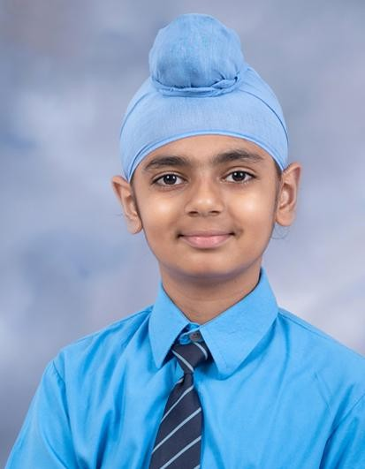
MERIT SCHOLARS
Eshaan Garg

Slide 12
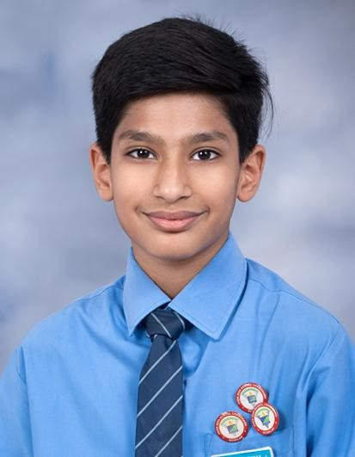
MERIT SCHOLARS
Samreen Kang

Slide 13
MERIT SCHOLARS
Advika Jain

Slide 14
MERIT SCHOLARS
Vedant Singla

Slide 15
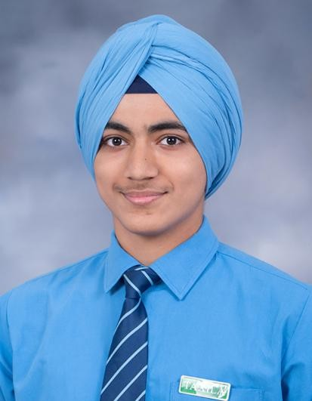
MERIT SCHOLARS
Kovid Aggarwal

Slide 16
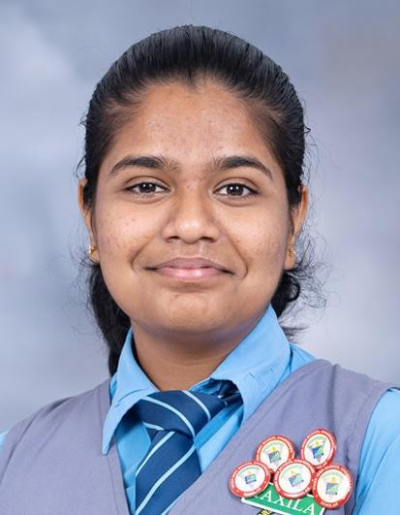
MERIT SCHOLARS
Shaurya Bansal

Slide 17
MERIT SCHOLARS
Shivank Kakkar

Slide 18
MERIT SCHOLARS
Kashvi Parmar

Slide 19
MERIT SCHOLARS
Mehakpreet Kaur

Slide 20
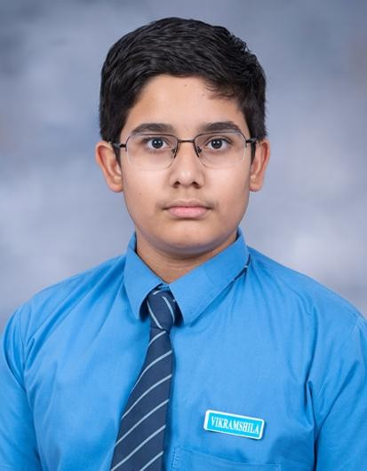
THE OUTSTANDING PROGRESS AWARD
Arbabjit Singh Gill
Class 7-D

Slide 21
HOUSE AWARDS
NL VK TX GN
NL VK TX GN

